Slide 1
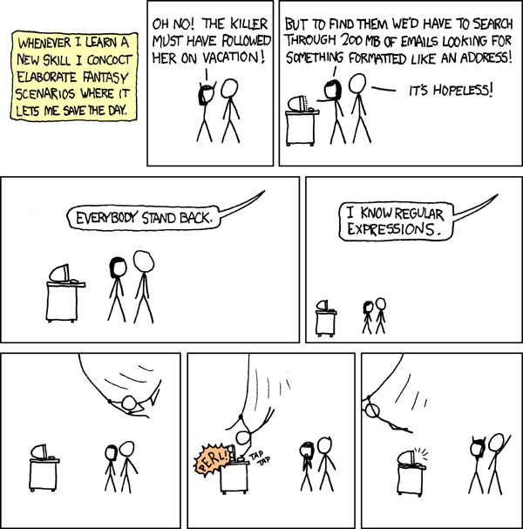
import re

Slide 2
Write only code
Slow performance for bad regexps
Case sensitive: “Lol” vs “lol”
Sensitiveness to problem changes
For simple queries, built-in function are much more efficient
Difficult to read
(?:[a-z0-9!#$%&'*+/=?^_`{|}~-]+(?:\.[a-z0-9!#$%&'*+/=?^_`{|}~-]+)*|\"(?:[\x01-\x08\x0b\x0c\x0e-\x1f\x21\x23-\x5b\x5d-\x7f]|\\[\x01-\x09\x0b\x0c\x0e-\x7f])*\")@(?:(?:[a-z0-9](?:[a-z0-9-]*[a-z0-9])?\.)+[a-z0-9](?:[a-z0-9-]*[a-z0-9])?|\[(?:(?:25[0-5]| 2[0-4][0-9]|[01]?[0-9][0-9]?)\.){3}(?:25[0-5]|2[0-4][0-9]|[01]?[0-9][0-9]?|[a-z0-9-]*[a-z0-9]:(?:[\x01-\x08\x0b\x0c\x0e-\x1f\x21-\x5a\x53-\x7f]|\\[\x01-\x09\x0b\x0c\x0e-\x7f])+)\])

Slide 3
Simple rules
Rule | Description | Example | Result
. | Any symbol except new line \n | e.e | eye, elephant, exe, prelevement
\d | Any digit | \ds | In the beginning of 60s
\D | Any symbol, except digits | \D | In the beginning of 60s
\s | Any whitespace symbol | M \s S | M Soyer, ISM series, GYM Section B
\S | Any non-whitespace symbol | \S123 | K1234, 1 + 123, #123
\w | Any letter, digit or underscore | \w\w\w\w | Year, K1_0, cubics
\W | Any symbol except letters, digits and underscore | quite\W | quite!, ‘quite, please’, quietest

Slide 4
Simple rules
Rule | Description | Example | Result
[..] | Any symbol in brackets, or within the range specified | [0-9][0-9A-Fa-f] | 12, 1F, 4S, E4
[..] | Any symbol in brackets, or within the range specified | gr[ae]y | Gray, grey
[^..] | Any symbol except specified in brackets | [^_^o] | 2^4, k_pop
 | Minus must be either in the end or in the beginning of matching letters | [abc-], [-1]
 | Only \ and ] symbols should be escaped | [*[(+\\\]\t]
\b | Word boundary | \bcorn\b | Pop corn, unicorn, corner
\b | Word boundary | \bcorn | Pop corn, unicorn, corner
\B | Not word boundary | corn\B | Pop corn, unicorns, corner

Slide 5
Quantifiers
Rule | Description | Example | Result
{n} | Exact n times | \d{4} | 12,123,1234,12345
{m,n} | From m to n times | \d{3,4} | 12,123,1234,12345
{m,} | At least m times | \d{3,} | 12,123,1234,12345
{,n} | At most n times | \d{,4} | 12,123,1234,12345
? | 0 or 1 entry = {0,1} | eggs? | eggs, eggy, egg
* | 0 or more times = {0,} | Ex\d* | Ex, Ex1, Ex12, Ex666
+ | 1 or more times = {1,} | Ba+m | Baaaaam, Bam, Bm
*? +? ?? {m,n}? | Quantifiers are greedy - accept the most possible number of symbols. Question mark make them lazy and take the least possible number of letters. | .*?- | Quantifiers are greedy - accept the most possible number of symbols.

Slide 6
Regular Expressions in Python
Function | Description | Example
re.search(pattern, string) | Find first match of pattern in string | re.search(r'\W+', 'Words, words, words.') - <_sre.SRE_Match object; span=(5, 7), match=', '>
re.fullmatch(pattern, string) | Check if the whole string matches the regular expression pattern | re.fullmatch(r'bar', 'barcode') - None
re.split(pattern, string, maxsplit=0) | Similar to str.split(). Splits string using pattern as separator | re.split(r'\W+', 'Words, words, words.') - ['Words', 'words', 'words', '']
re.findall(pattern, string) | Find all non-overlapping patterns in string | re.findall(r'\w+', 'Words, words, words.') - ['Words', 'words', 'words']
re.finditer(pattern, string) | Return an iterator with all non-overlapping matches of pattern in string. Empty matches are included in the result. | m=re.finditer(r'\w+', 'Words, words, words.') print([m1[0] for m1 in m])
re.sub(pattern, repl, string, count=0) | Substitute all non-overlapping matches of pattern for repl in string | re.sub(r'\w+','dog', 'Words, words, words.') - dog, dog, dog.

Slide 7
Escape
For regex .^$*+?{}[]\|() should be escaped with \.
For Python string variable \ should be escaped with \ as well.
re.search('\\\\par','\\\\par'):
\\\\par in Python is read as \\par, since first \ escapes second \.
\\par received by regex is read as \par, since first \ escapes second \.
Therefore \\\\par corresponds to \par in the end.
Instead, use re.search(r'\\par','\\\\par') where r tells Python not to treat \ as escape symbol (except the case of opening quotes).

Slide 8
Grouping and Enumerating (or operation)
Rule | Description | Example | Result
| | Logical Or | cat|dog|l[io]on | I have pets - 1 cat, 2 dogs, small loon; and I want to get a lion.
(..) | Grouping the pattern | ((\d)(\d))((\d)(\d)) | 123456789 -> 1234 -> 12 ->1,2 34 ->3,4
(?:..){x} | Grouping the pattern to be able to repeat it | (?:[0-9A-Fa-f]{2}[:-]){5}[0-9A-Fa-f]{2} | 01:23:45:67:89:ab

Slide 9
Examples
Example | Result
(?:\w\w\d\d)+ | I saw ISE14a, MUI86, but one told me about ISE13MUI76.
(?:\w+\d+)+ | I saw ISE14a, MUI86, but one told me about ISE13MUI76.
(?:\+33|07|06)(?: \d{2,3}){4} | +33 761 61 24 22, 07 61 61 24 22, 06 61 61 24 22
(?:[Hh][aoeiy]+)+ | Hahahahahaa, hahahihihihi, hyperactive
\b(?:[Hh][aoeiy]+)+\b | Hahahahahaa, hahahihihihi, hyperactive
re.sub(r'(\d\d)/(\d\d)/(\d{4})', r'\2.\1.\3', text) | text: "We arrive on 03/25/2018. So you are welcome after 04/01/2018." Out: "We arrive on 25.03.2018. So you are welcome after 01.04.2018."

Slide 10
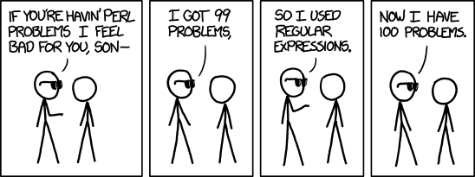
LABS TIME

